Slide 1
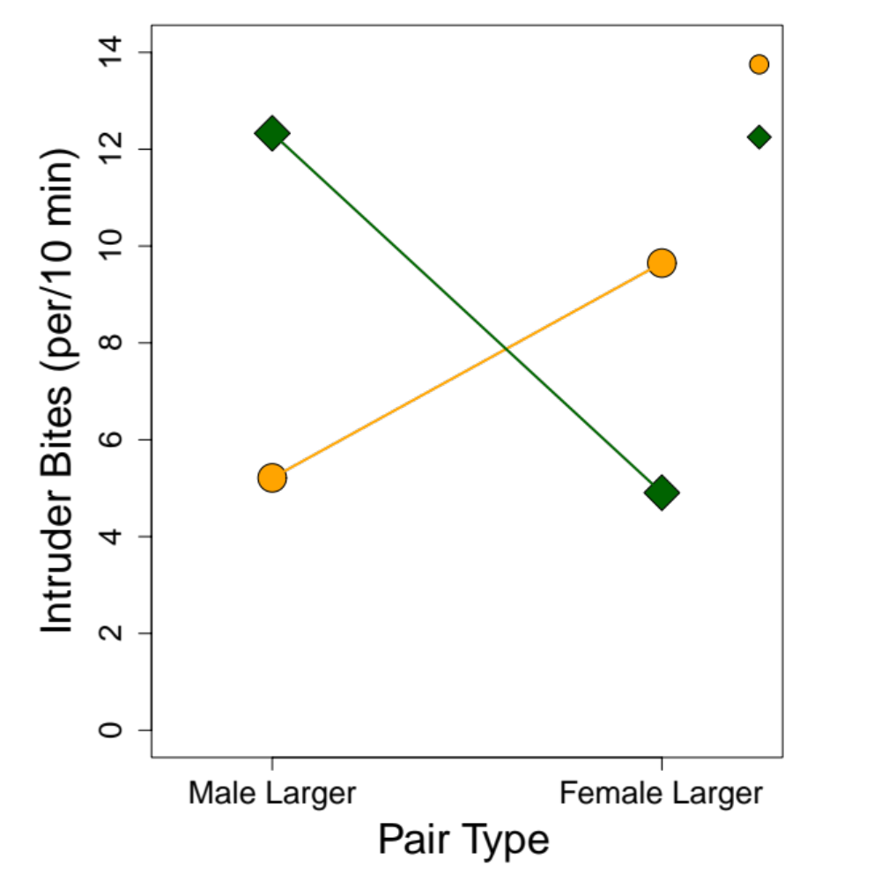
Female intruder
Male intruder
p = 0.004
p = 0.012
p = 0.020
p = 0.046

